Slide 1





Multi-modal image fact classification and grounding for long-tailed multi-label classification of chest X-ray images
MICCAI 2024 Challenge: 3rd place in CXR-LT Task 3
Pablo Messina
PUC Chile, CENIA, iHEALTH
Oct 10, 2024

Slide 2
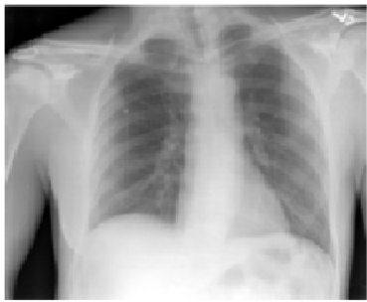
Motivation: open-vocabulary classification and visual grounding of facts
Image
Objective 1: Is the fact present or absent in this image? (Binary classification)
Multi-modal
Vision-Language
Model
Fact
“cardiac silhouette is enlarged”
Objective 2: If the fact is true, find the regions in the image where the fact is present (Visual Grounding)

Slide 3
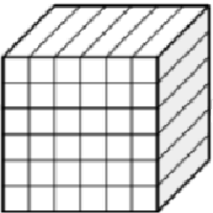
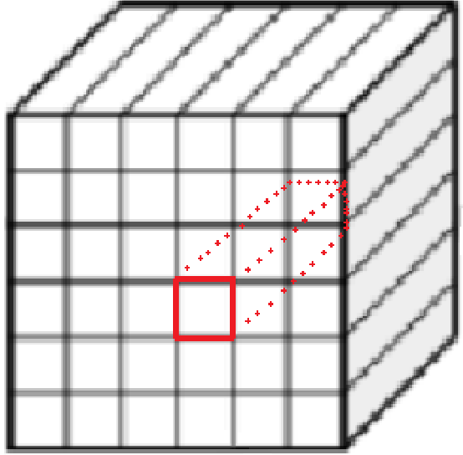


Model Architecture: Input Encoding
Image
Add 2D Positional Encoding (Optional)
Image
Encoder
Local image features
Fact
CXR Fact Encoder
“cardiac silhouette is enlarged”
Local image feature vector at position (i, j)
Fact embedding
Global image feature vector
[1] Messina, P., Vidal, R., Parra, D., Soto, Á., & Araujo, V. (2024). Extracting and Encoding: Leveraging Large Language Models and Medical Knowledge to Enhance Radiological Text Representation. In Findings of the Association for Computational Linguistics ACL 2024 (pp. 3955–3986). Bangkok, Thailand. https://doi.org/10.18653/v1/2024.findings-acl.236

Slide 4
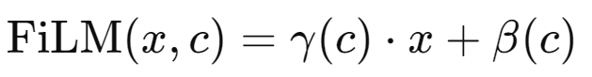
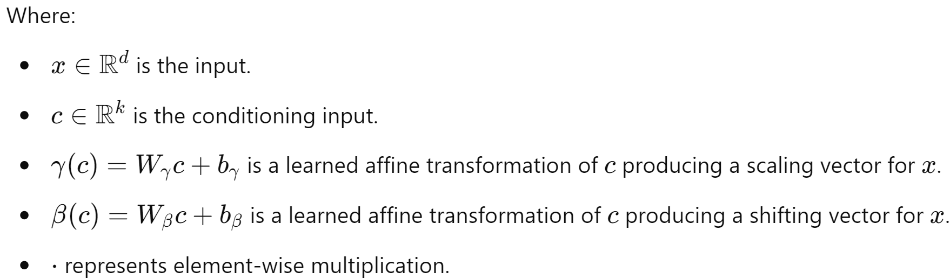
Model Architecture: Fact Visual Grounding
Global image feature vector
FiLM
Linear Layer + ReLU
Linear Layer
Binary Classification
Is the fact present at location (i,j)?
Local image feature vector at position (i, j)
Concatenate
FiLM
Sigmoid
Fact embedding
[2] Perez, Ethan, et al. "Film: Visual reasoning with a general conditioning layer." Proceedings of the AAAI conference on artificial intelligence. Vol. 32. No. 1. 2018. https://ojs.aaai.org/index.php/AAAI/article/view/11671

Slide 5
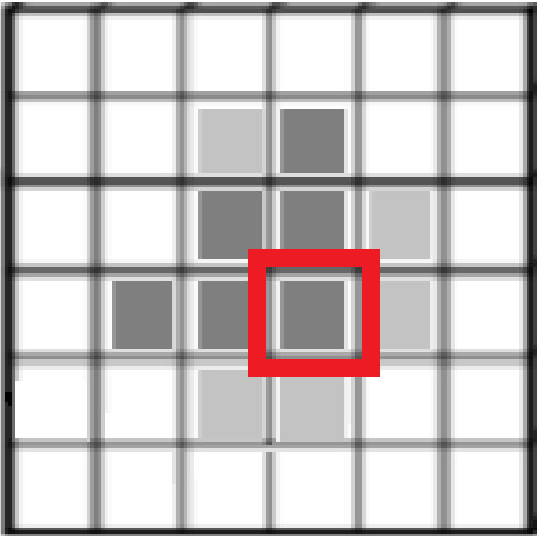

Model Architecture: Fact Classification
Global image feature vector
FiLM
Linear Layer + ReLU
Linear Layer
Local image feature vector at position (i, j)
Concatenate
FiLM
Sigmoid
Weighted Average
Fact embedding
Binary Classification
Is the fact present in the whole image?
MLP
Sigmoid

Slide 6
Model Architecture: Fact Classification
Global image feature vector
FiLM
Linear Layer + ReLU
Linear Layer
Local image feature vector at position (i, j)
Concatenate
FiLM
Sigmoid
Weighted Average
Fact embedding
Binary Classification
Is the fact present in the whole image?
MLP
Sigmoid
This is the output used for the challenge

Slide 7
Converting classes into facts
General conversion template:
“class”
“{class} seen”
Exceptions:
“pleural other”
“pleural abnormalities seen”
“round(ed) atelectasis”
“round atelectasis seen”
“hilum”
“hilar abnormalities seen”

Slide 8
Converting classes into facts
General conversion template:
“class”
“{class} seen”
Exceptions:
“pleural other”
“pleural abnormalities seen”
“round(ed) atelectasis”
“round atelectasis seen”
“hilum”
“hilar abnormalities seen”
NOTE: “hilum” is an anatomical structure, whereas “hilar abnormalities seen” denotes an abnormality observed (different semantics)

Slide 9
Ensembling classifiers
For each class i from 1 to 45:
Class i probabilities for validation examples
Option 1: Convex Combination
Find optimal weights for a convex linear combination of predicted probabilities to maximize MAP.
Weights are iteratively refined through random sampling and resampling around the best results.
Option 2: Logistic Regression
Use predicted probabilities as features in a logistic regression model to learn the optimal ensemble.
Model 1
0.3 | 0.7 | 0.5 | … | 0.4
0.5 | 0.8 | 0.9 | … | 0.4
0.4 | 0.1 | 0.5 | … | 0.5
… | … | … | … | …
0.4 | 0.6 | 0.8 | … | 0.7
0 | 1 | 1 | … | 0
Model 2
Model 3
…
Model K
Ground Truth

Slide 10
Datasets: Official challenge data (1/8)
Training set: 258,871 images with labels for 40 classes with public noisy labels.
Development set: 39,293 images with hidden labels, but usable for validation.
Test set: 78,946 images with hidden labels.
All images coming from MIMIC-CXR [3].
All labels are extracted from the reports by RadText [4] (tasks 1, 2, 3) or by radiologists in a small test set subset (task 2)
[3] Johnson, Alistair EW, et al. "MIMIC-CXR-JPG, a large publicly available database of labeled chest radiographs." arXiv preprint arXiv:1901.07042 (2019).
[4] Wang, Song, et al. "Radiology text analysis system (RadText): architecture and evaluation." 2022 IEEE 10th International Conference on Healthcare Informatics (ICHI). IEEE, 2022.

Slide 11

Datasets: GPT-4 labels from MIMIC-CXR reports (2/8)
Key idea: use GPT-4 to logically infer the presence or absence of a class in a report
Prompt’s instructions:
Given a report (#R) and a hypothesis (#H), output "Reason: {reason}. Label: {label}" where {reason} is one or two short explanation sentences and {label} is one of {definitely true, likely true, unknown, likely false, definitely false}. Be careful with tricky sentences that mention multiple findings. Remember that unknown applies when both #R and #H might be true but there is no conclusive way to know with the information provided.
Instructions
Reason: {reason}. Label: {label}
Here label can be one of:
Definitely true (positive)
Likely true (positive)
Unknown (negative)
Likely false (negative)
Definitely false (negative)
#R: {report} | #H: {fact}

Slide 12
Datasets: GPT-4 labels from MIMIC-CXR reports (2/8)
Statistics:
Training set: 229,760 image-class pairs (145,680 images)
Dev set: 25,764 image-class pairs (18,070 images)
Test set: 33,197 image-class pairs (21,282 images)

Slide 13
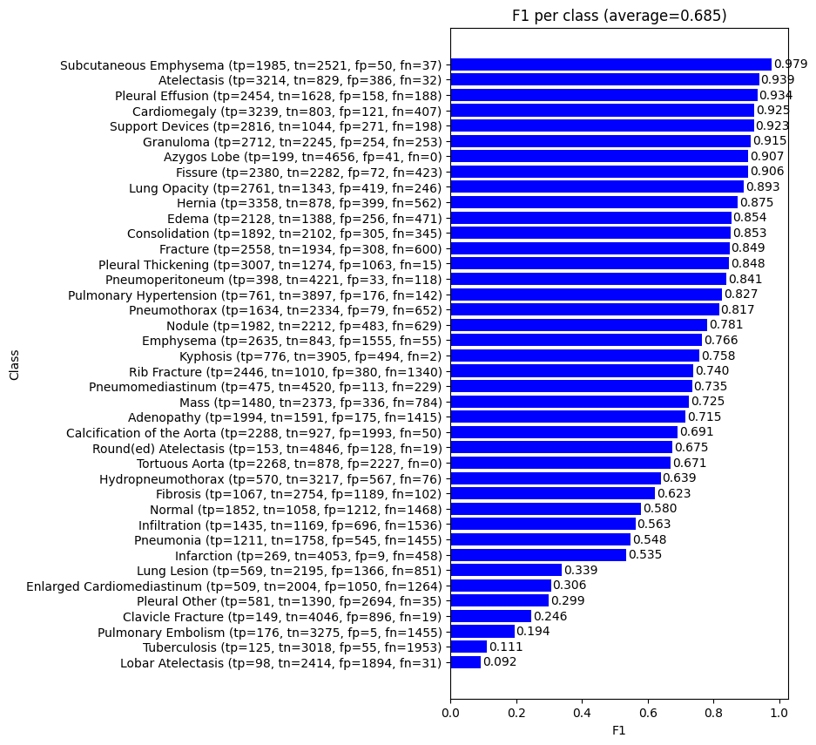
Datasets: GPT-4 labels from MIMIC-CXR reports (2/8)
Observations:
Significant disagreement between GPT-4 and official public challenge labels (macro-average F1= 0.685)
Manual inspection reveals GPT-4 is generally right.

Slide 14
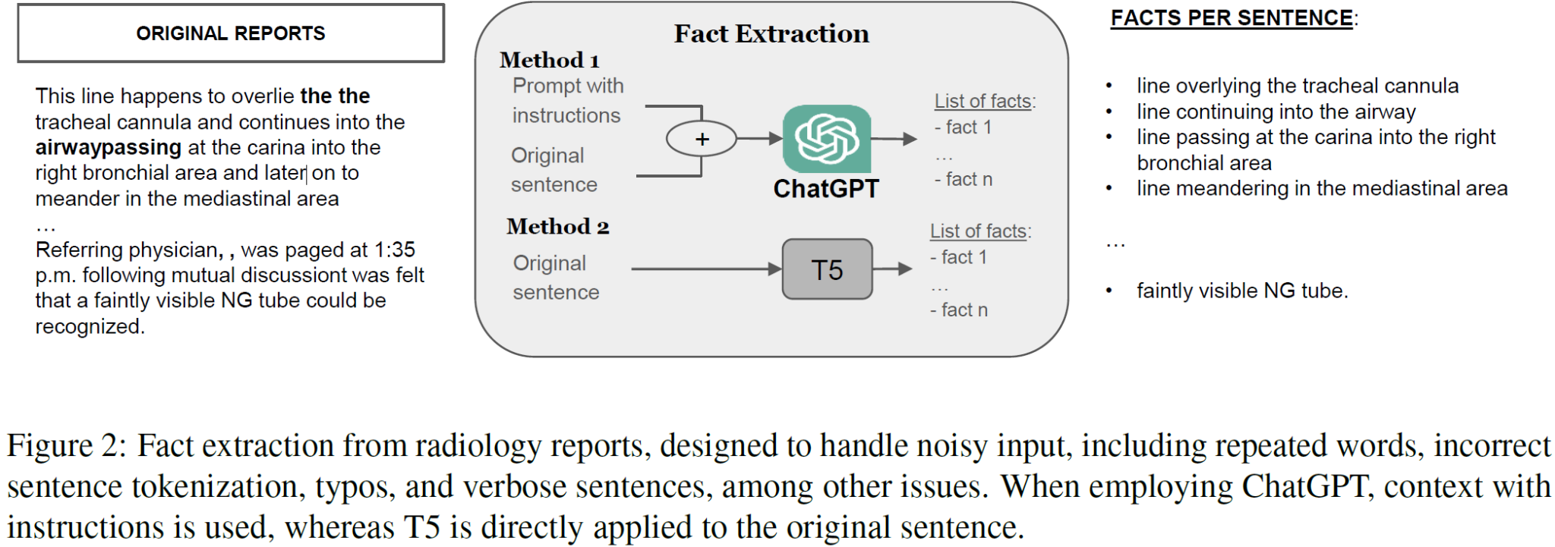
Datasets: facts extracted from MIMIC-CXR reports (3/8)
Fact extracted from reports using ChatGPT (GPT-3.5, GPT-4) and T5, as per [1].
583,202 facts in total (positive)

Slide 15
Datasets: facts extracted from MIMIC-CXR reports (3/8)
Fact extracted from reports using ChatGPT (GPT-3.5, GPT-4) and T5, as per [1].
583,202 facts in total (positive)
Random negative sampling + lightweight Natural Language Inference (NLI) model to find negative facts per report. Only keep fact if it is NOT entailed by the report’s facts.
~500 negative facts per report
Report
Fact extraction
fact 1
fact 2
…
fact N
CXR Fact Encoder
randomly sampled non-positive fact
most
sim
query *
most sim
neg
least sim
avg pool
max
pool
Concatenation
MLP
3-class softmax
(entailment, contradiction, or neutral)

Slide 16
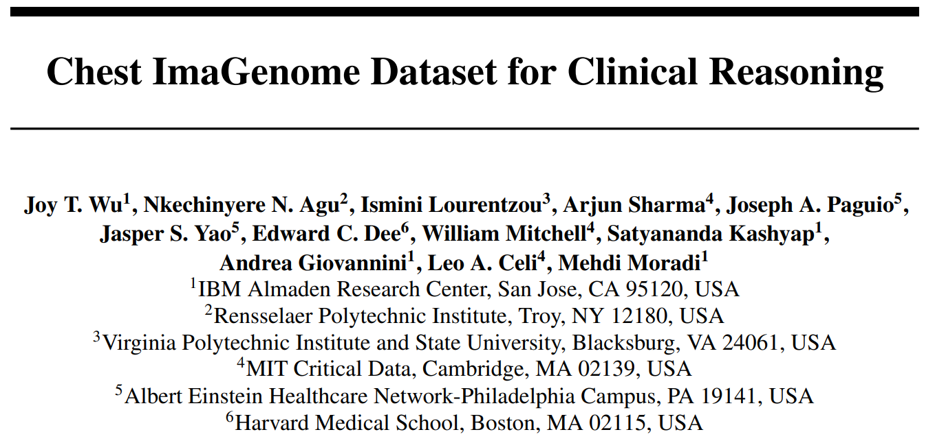
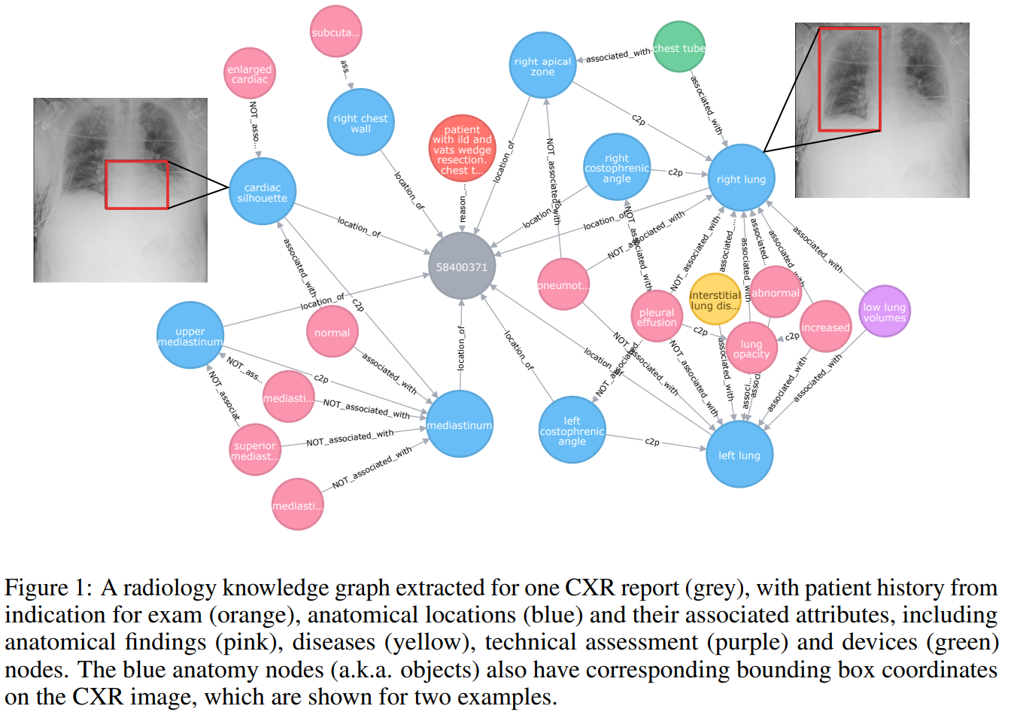
Datasets: Chest ImaGenome bounding boxes (4/8)
242,072 frontal images from MIMIC-CXR
36 bounding box classes

Slide 17
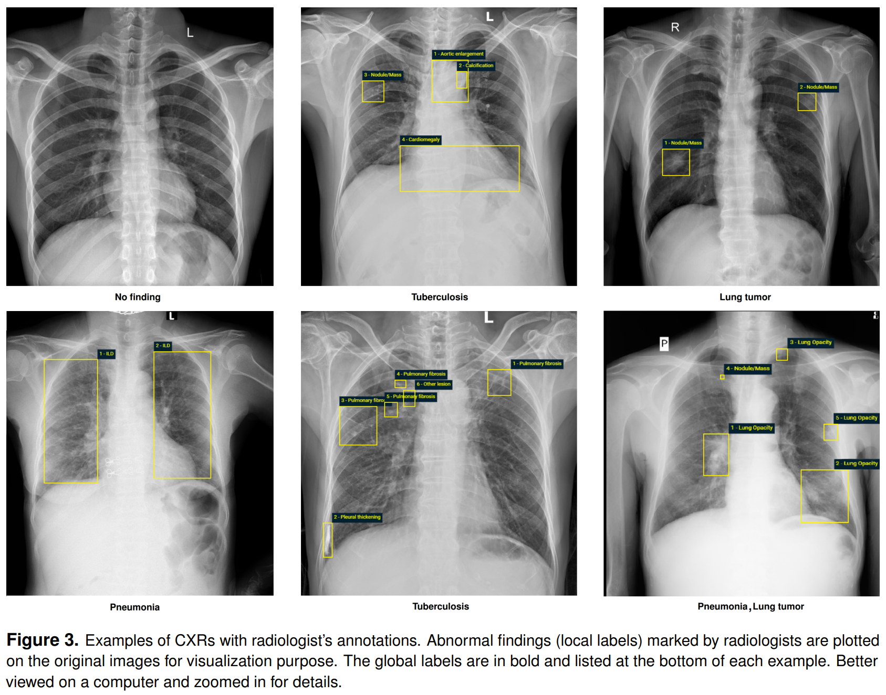
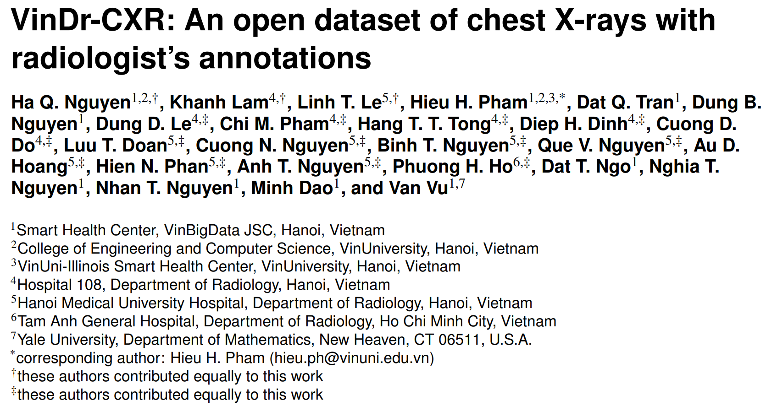
Datasets: VinDR-CXR (5/8)
18,000 images
22 localized classes with bounding boxes
6 global classes

Slide 18
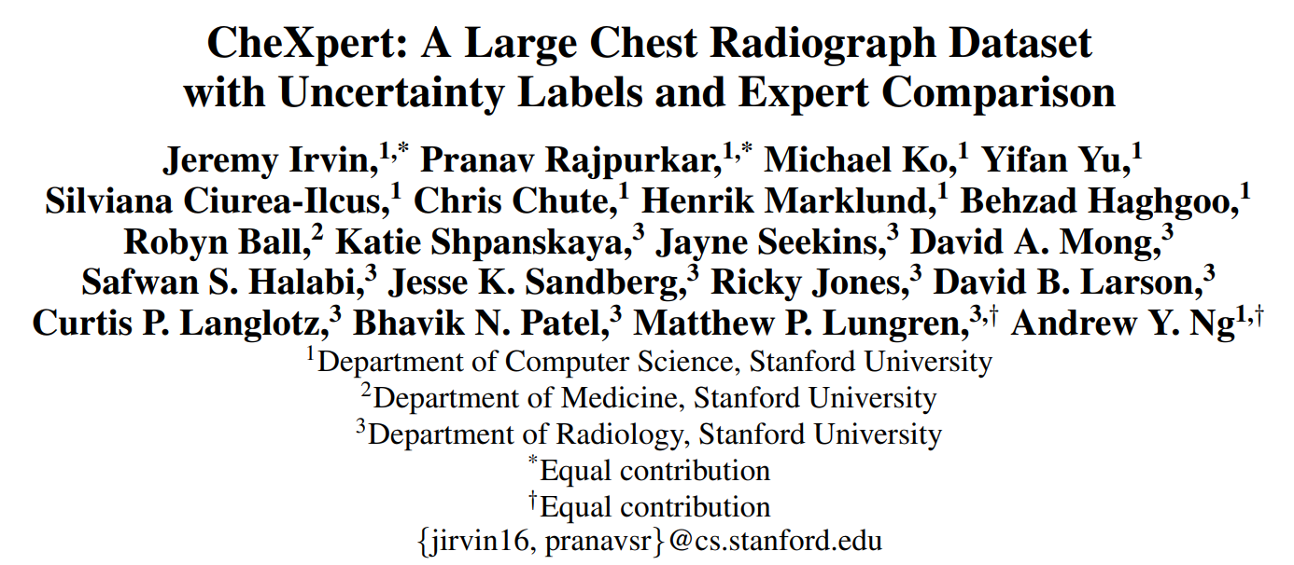
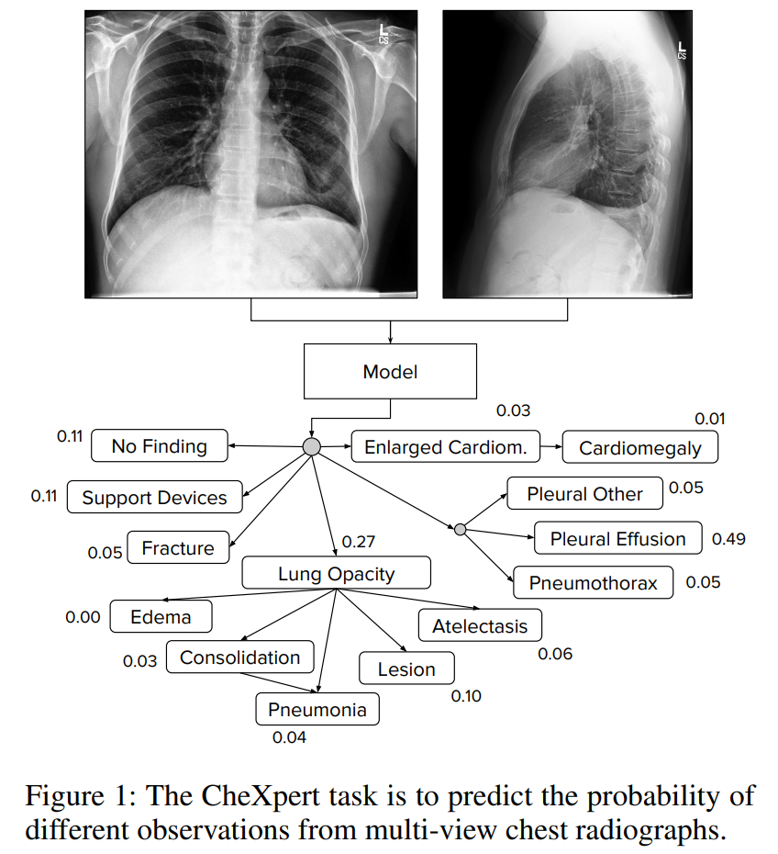
Datasets: CheXpert (6/8)
224,316 images
14 classes

Slide 19
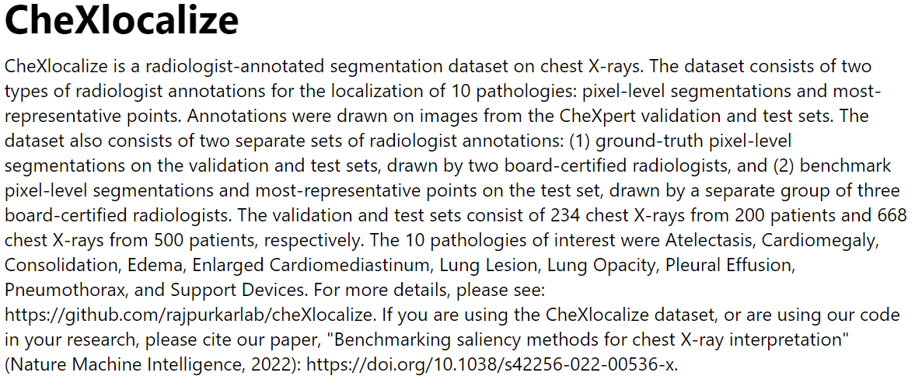
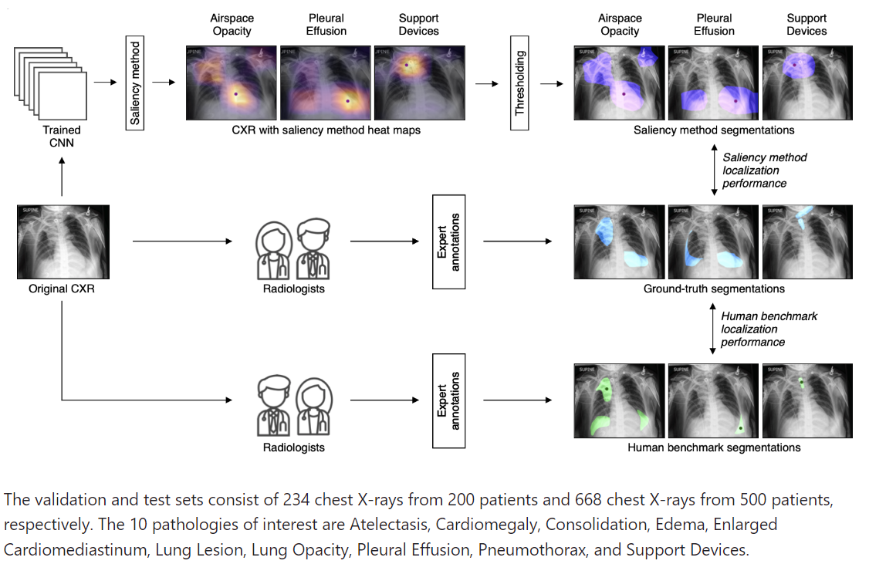
Datasets: CheXlocalize (7/8)
902 images
10 classes with segmentation masks

Slide 20
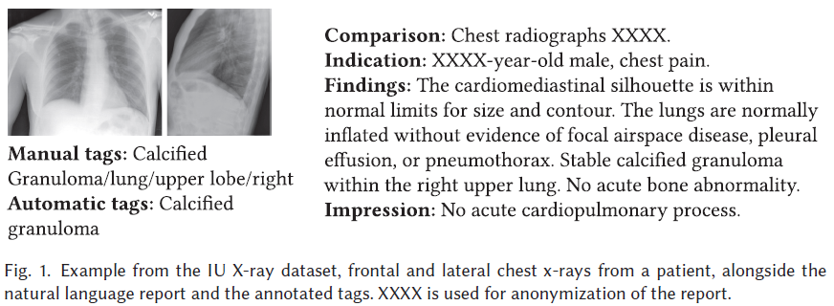
Datasets: IU X-ray (8/8)
7470 images
3955 reports
2331 unique tags manually & automatically annotated
Tags converted to facts using GPT-4

Slide 21
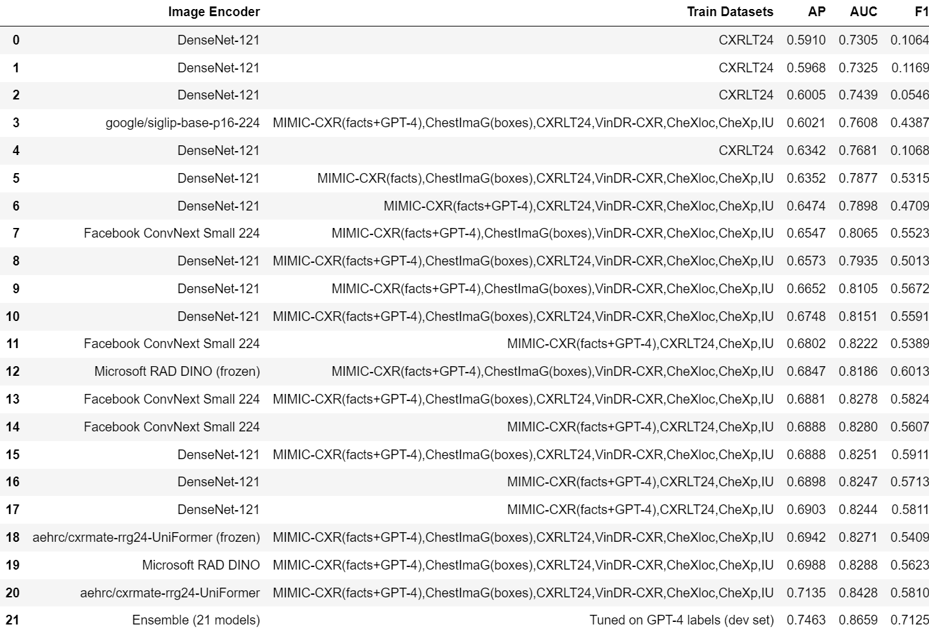
Results with GPT-4 labels (test set)
Ensemble of 21 models achieves ~0.74 AP on GPT-4 labels (average of all 45 classes)

Slide 22
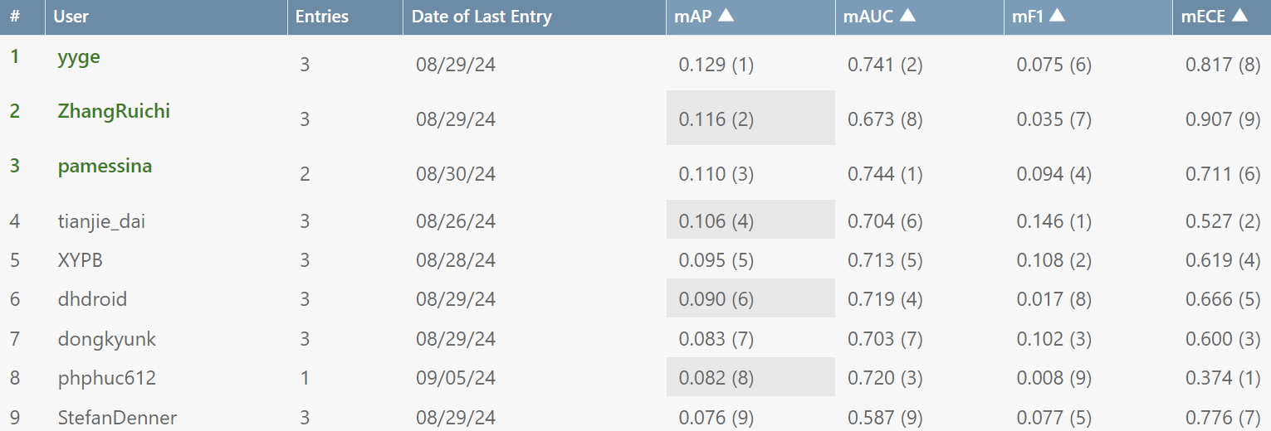
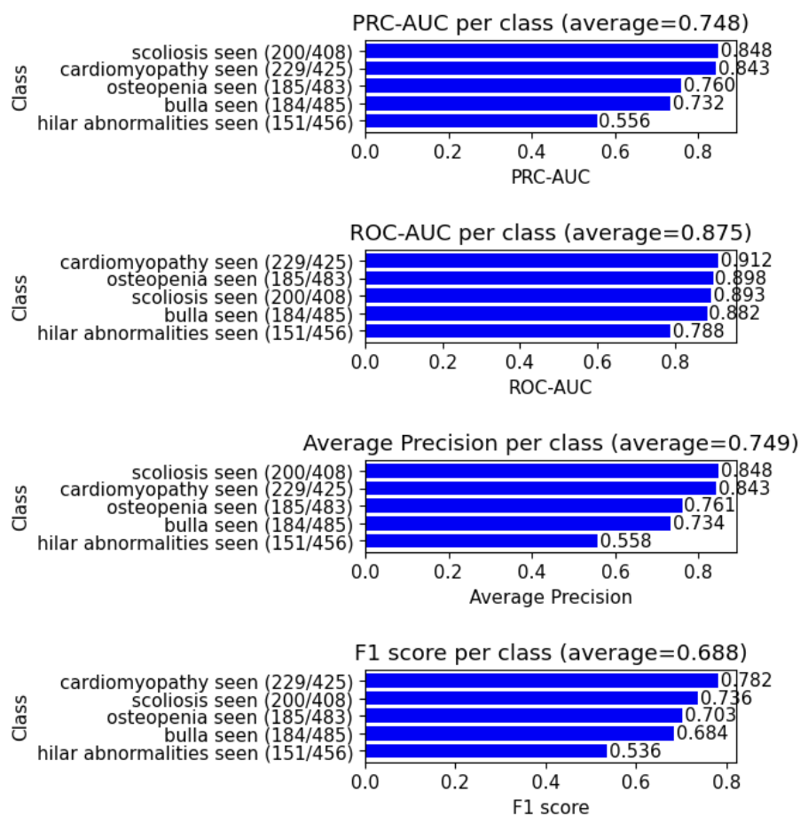
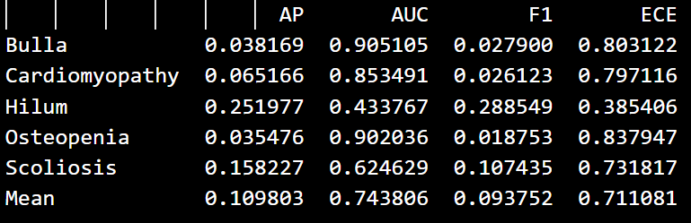
Results in Task 3: Official vs. GPT-4
Official results
GPT-4 results
NOTE: my best class according to the challenge (“hilum”) is my worst class according to GPT-4 (“hilar abnormalities seen”) !!

Slide 23
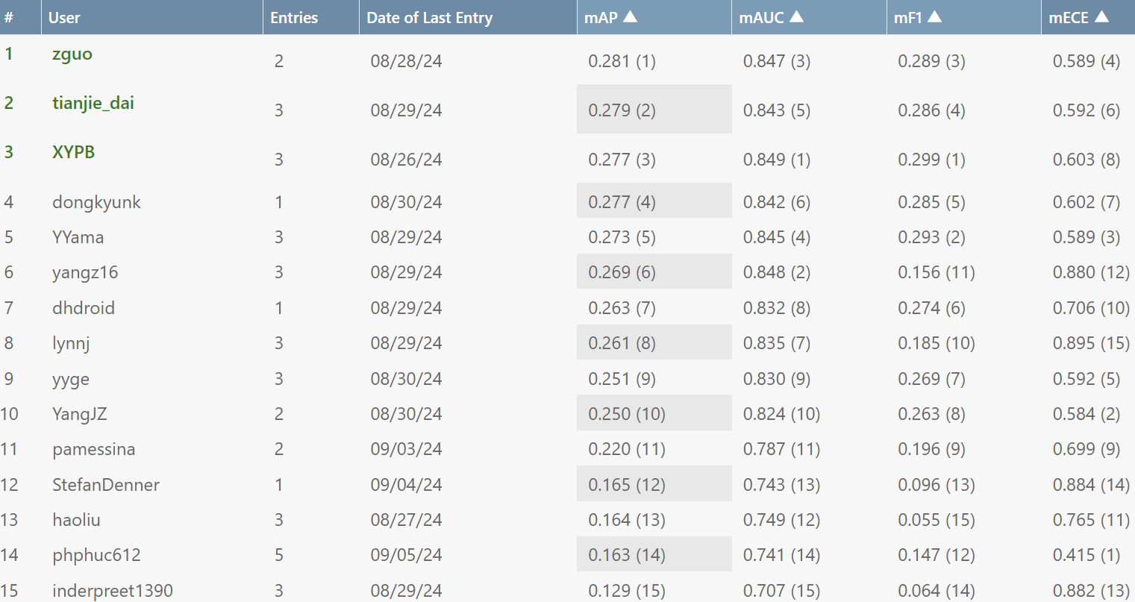
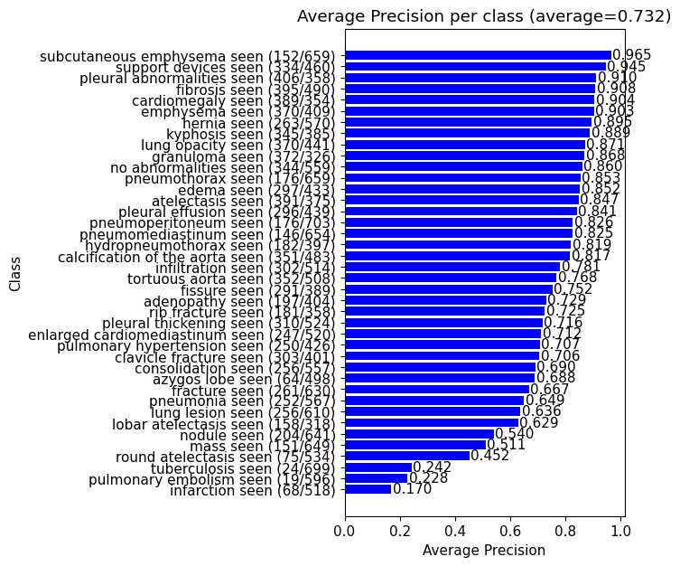
Results in Task 1: Official vs. GPT-4
Official results
GPT-4 results

Slide 24
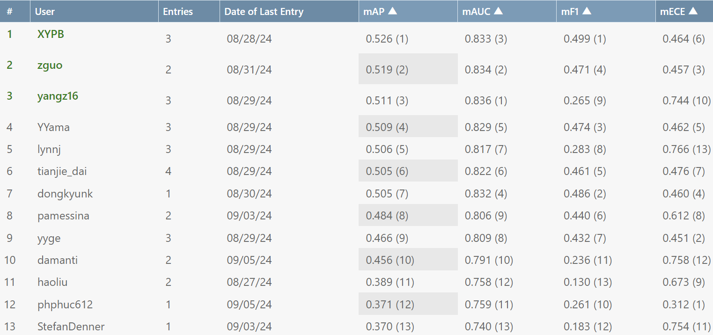
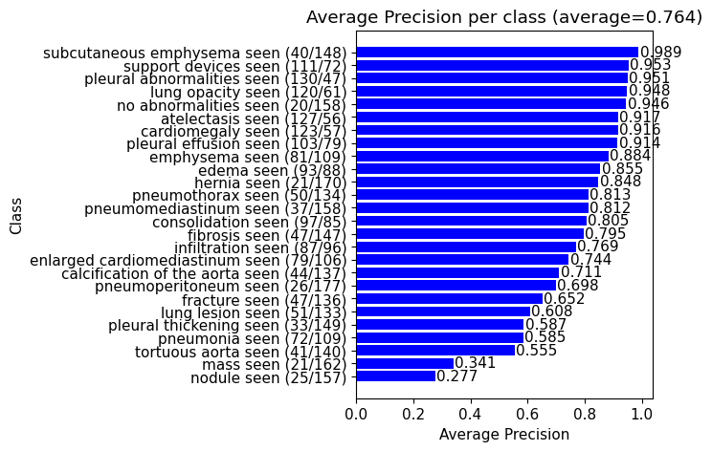
Results in Task 2: Official vs. GPT-4
Official results
GPT-4 results

Slide 25

Conclusions & Future Work
Conclusions
Relatively good performance according to GPT-4 labels.
Discrepancy between GPT-4 and official noisy labels (Tasks 1 & 3). Manual inspection suggests GPT-4 is generally right.
Discrepancy between GPT-4 and manually-annotated labels (Task 2). Looking forward to the release of these gold labels by the organizers to be able to perform a more detailed error analysis
Future Work
Perform detailed error analysis (of GPT-4 and the fact classification model)
Use multiple views
Improve the visual grounding architecture (Ideas: SAM, U-NET, YOLOv8, DETR, etc.)
Include more datasets for visual grounding (object detection, segmentation)

Slide 26
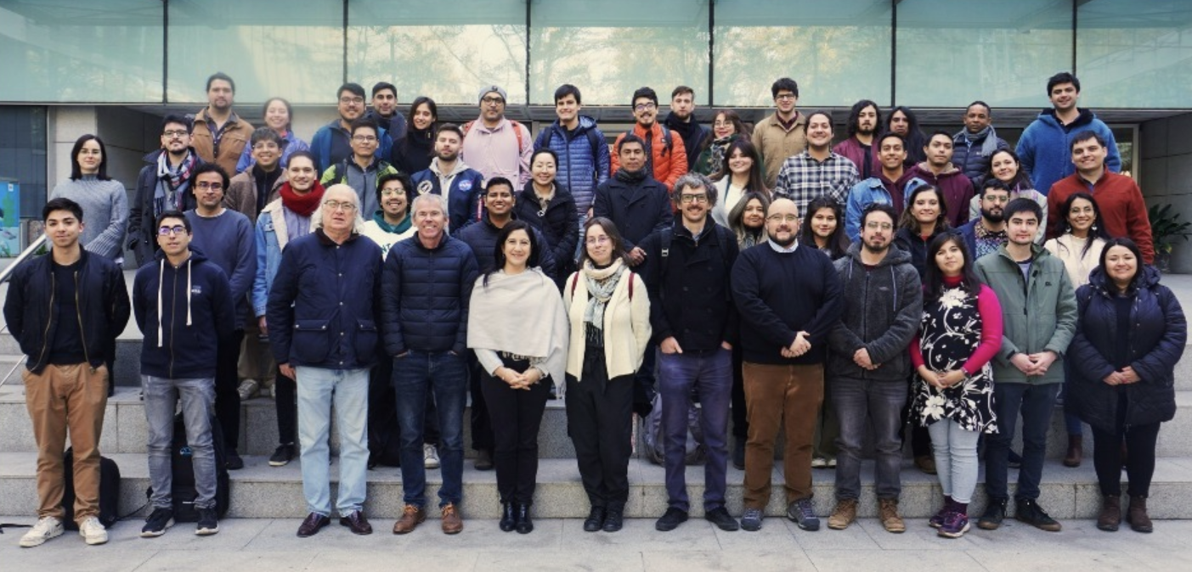
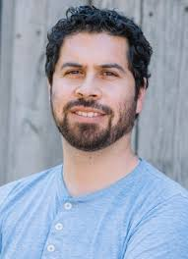
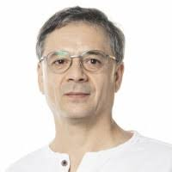
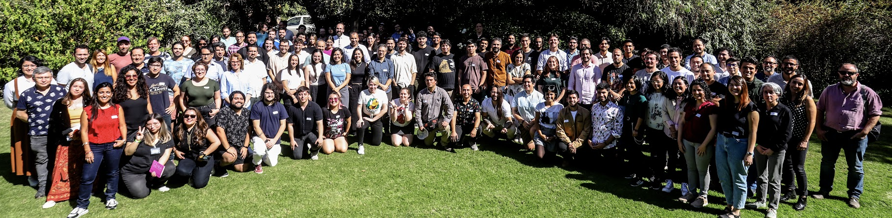


Acknowledgements
Denis Parra
PUC Chile
Álvaro Soto
PUC Chile
René Vidal
UPenn
Yuyan Ge
UPenn

Slide 27

Thank you!
Code is available at https://github.com/PabloMessina/MedVQA/
For discussion, please feel free to reach out to Pablo Messina at pamessina@uc.cl

